Slide 1


Two Sigma Investments - Team Airports
Jonathan Kroll
Chaoping Deng
Yuichiro Yasutomo
Hao Zheng
Ying Zhu

Slide 2
Our Evolution
v
Today
v

Slide 3
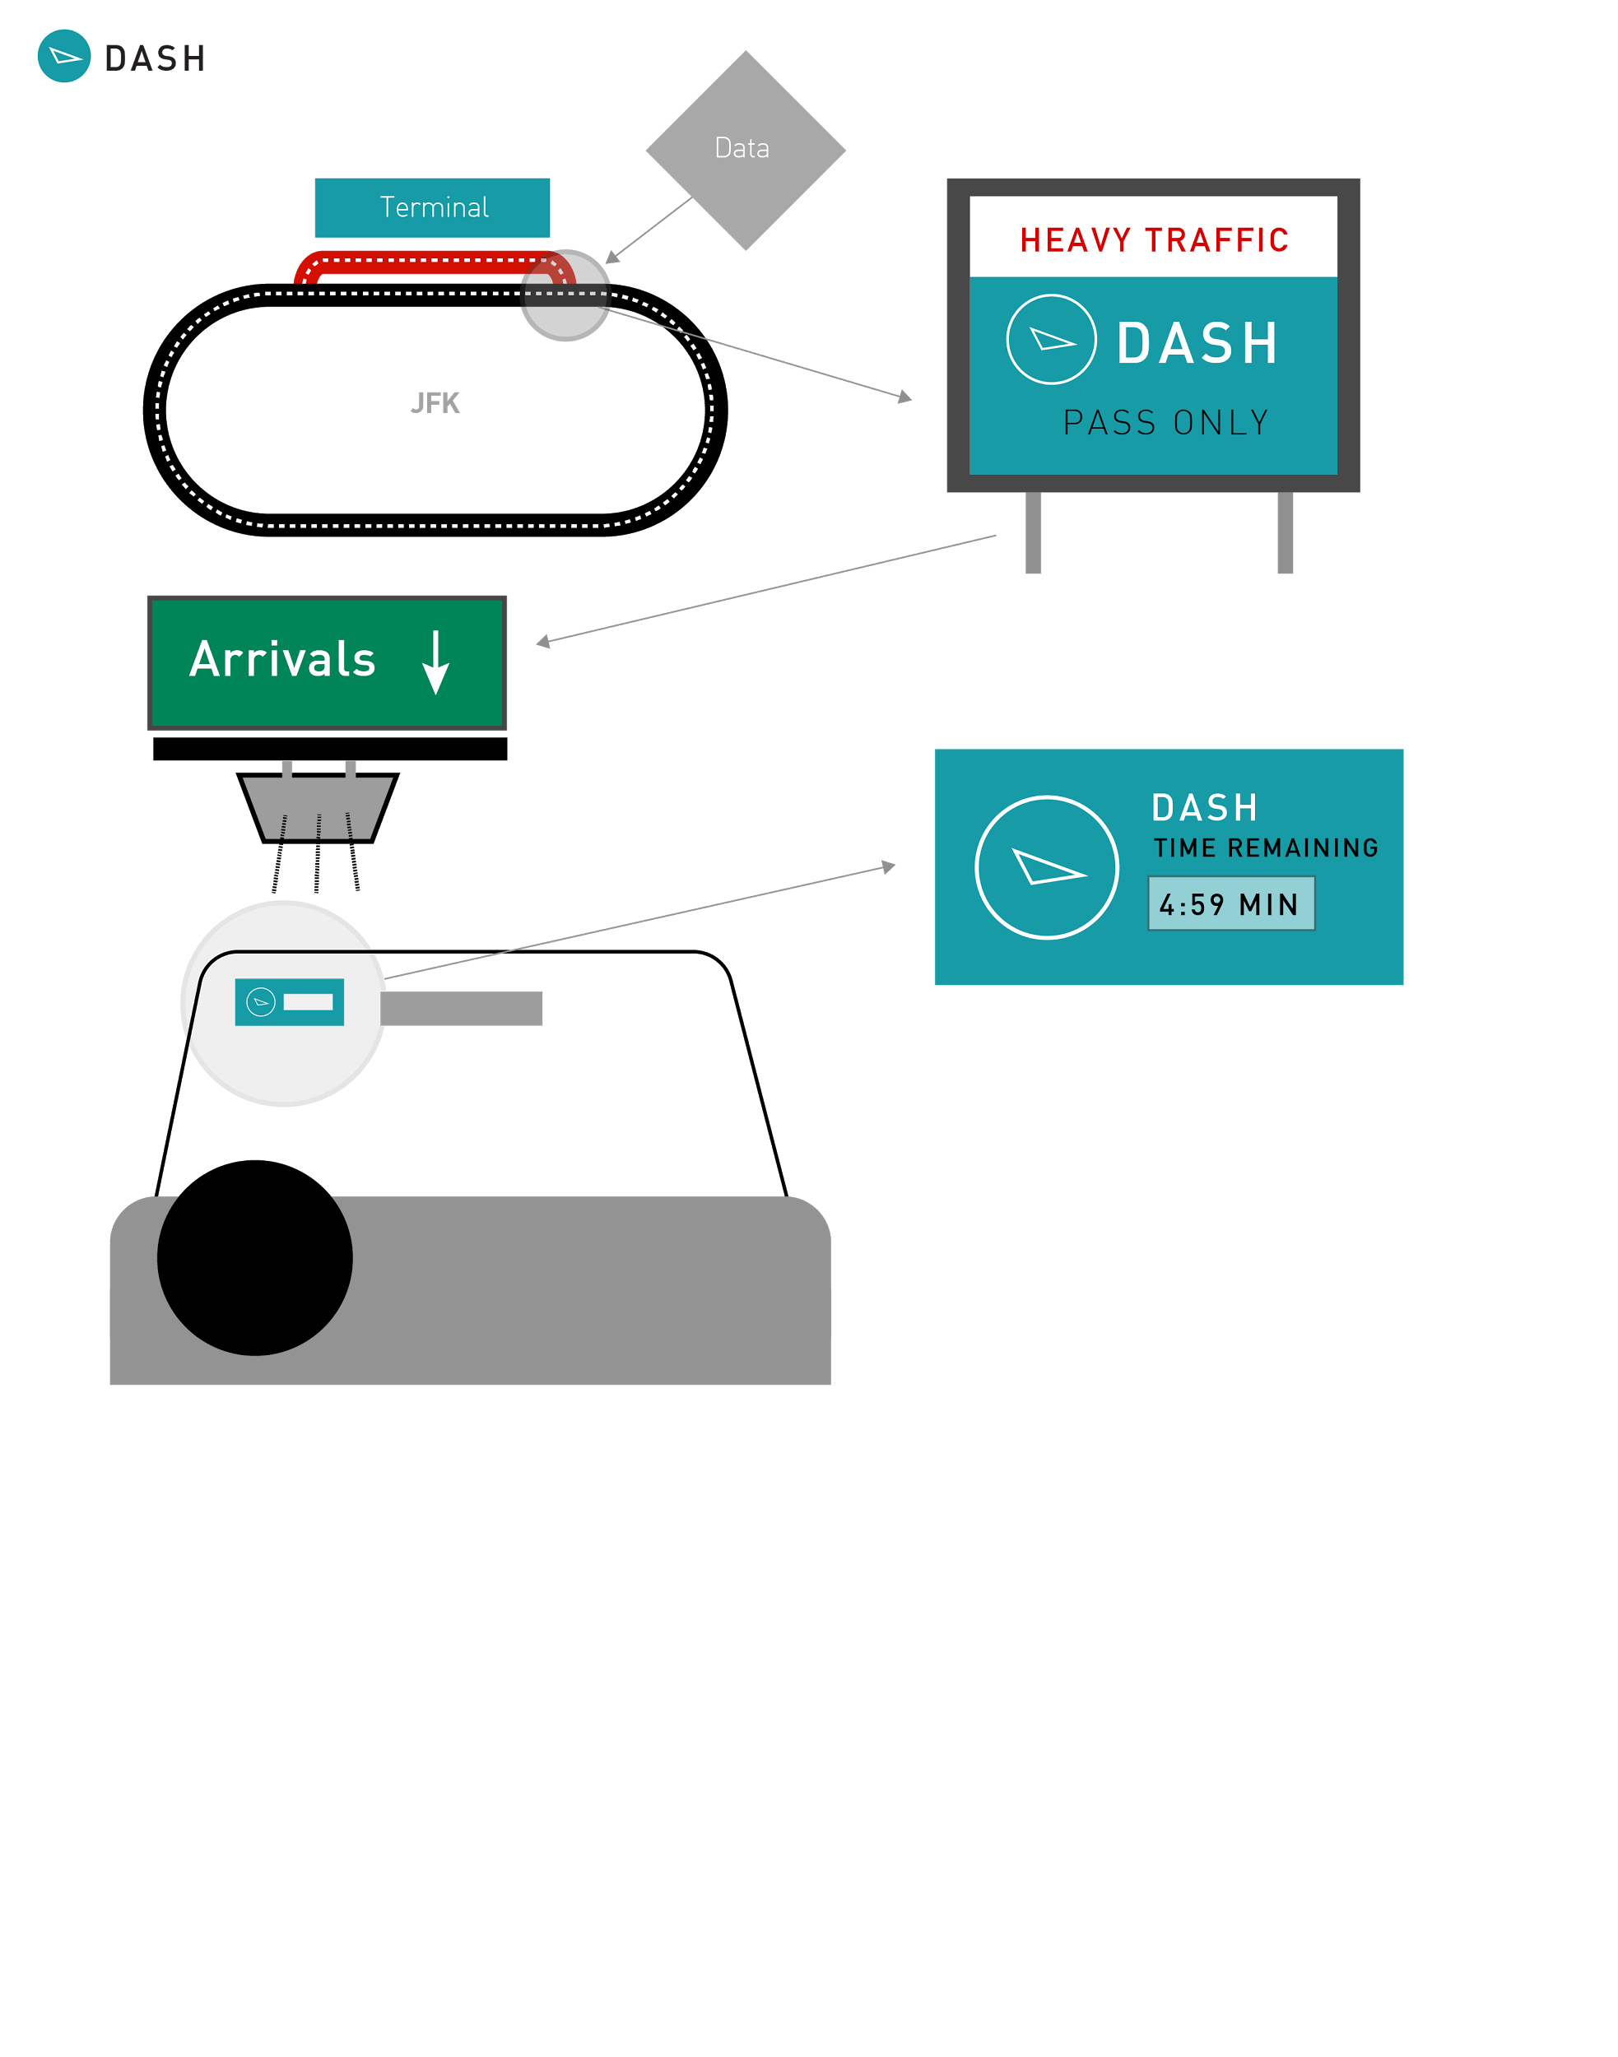
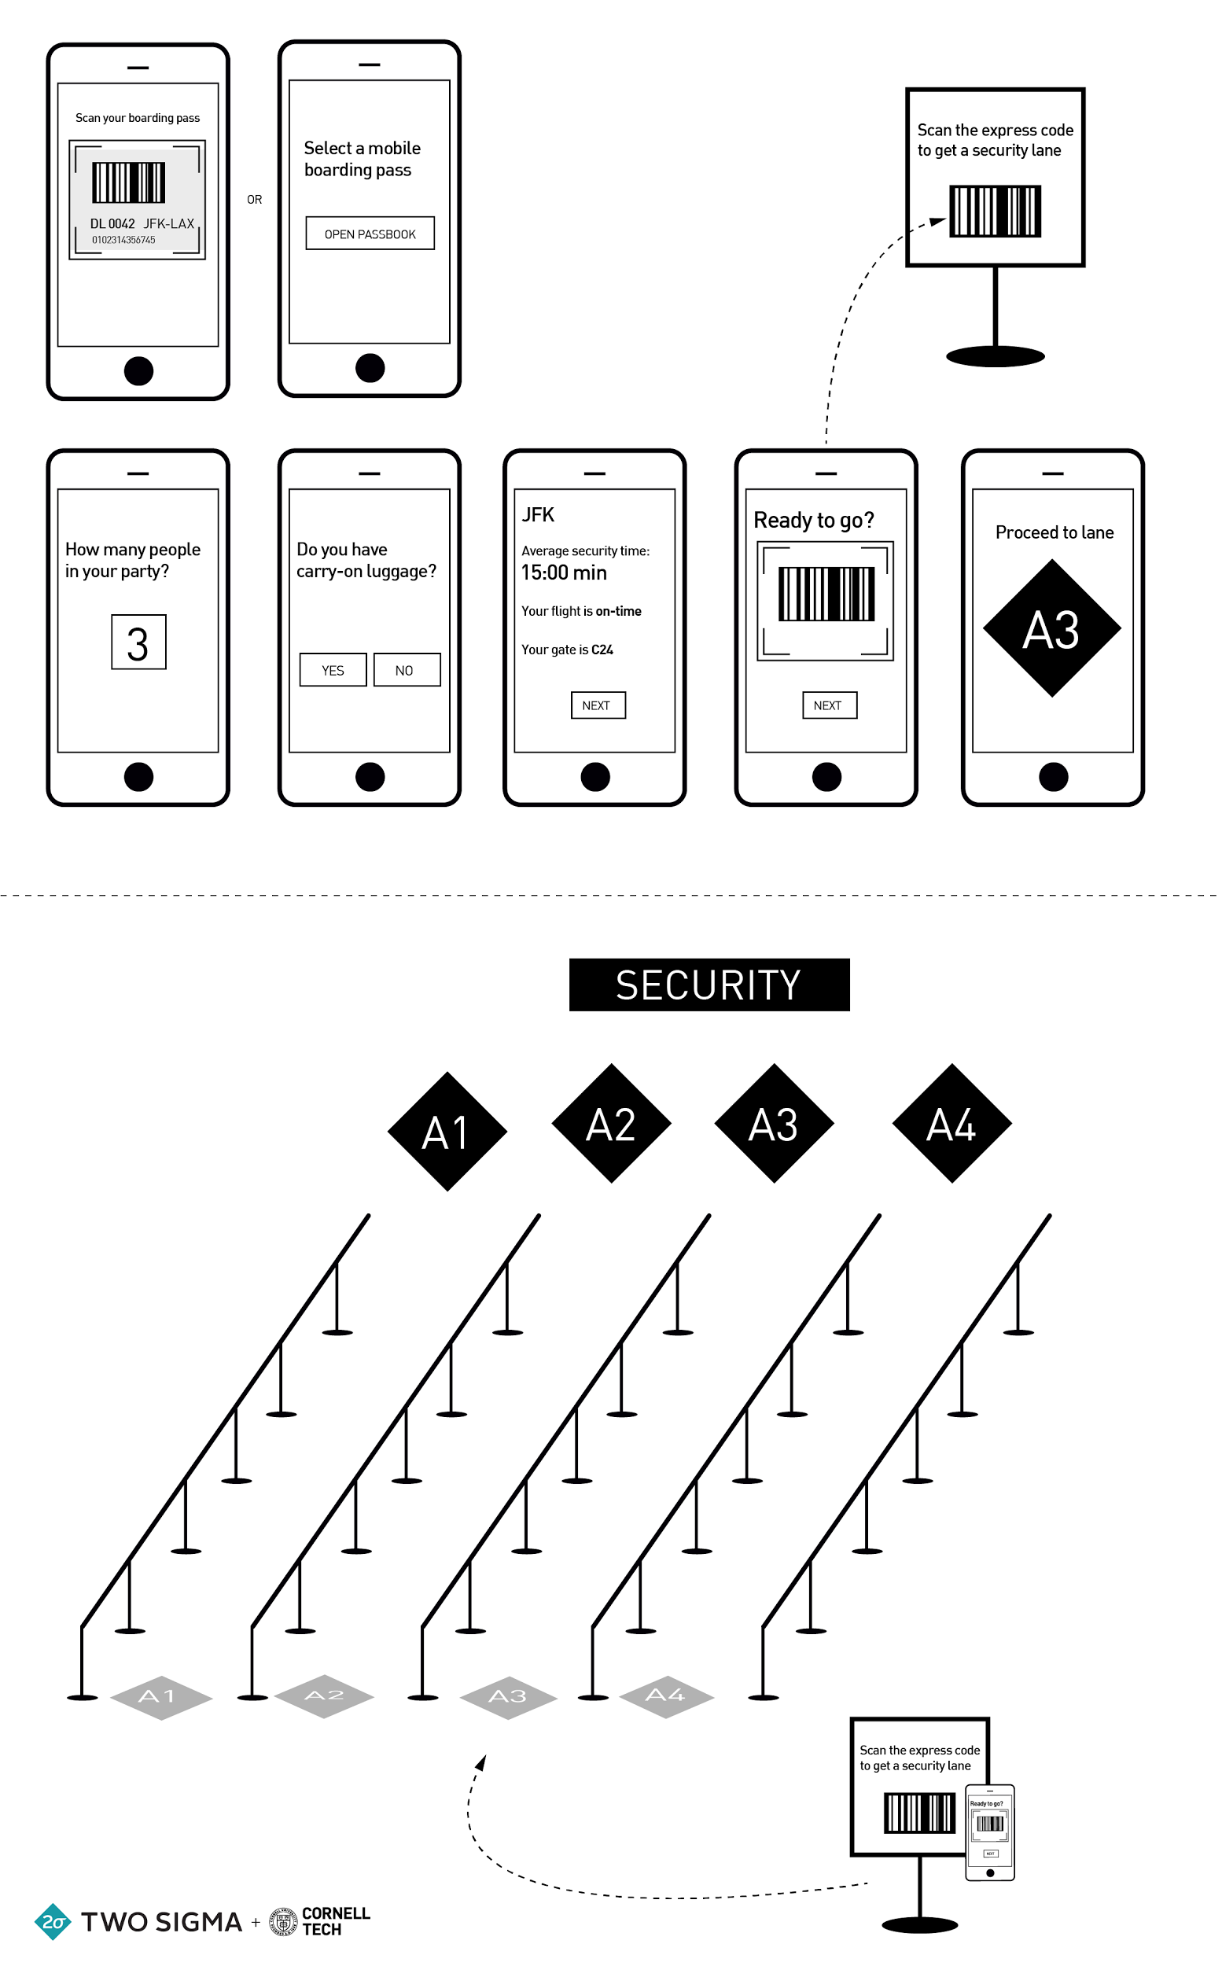
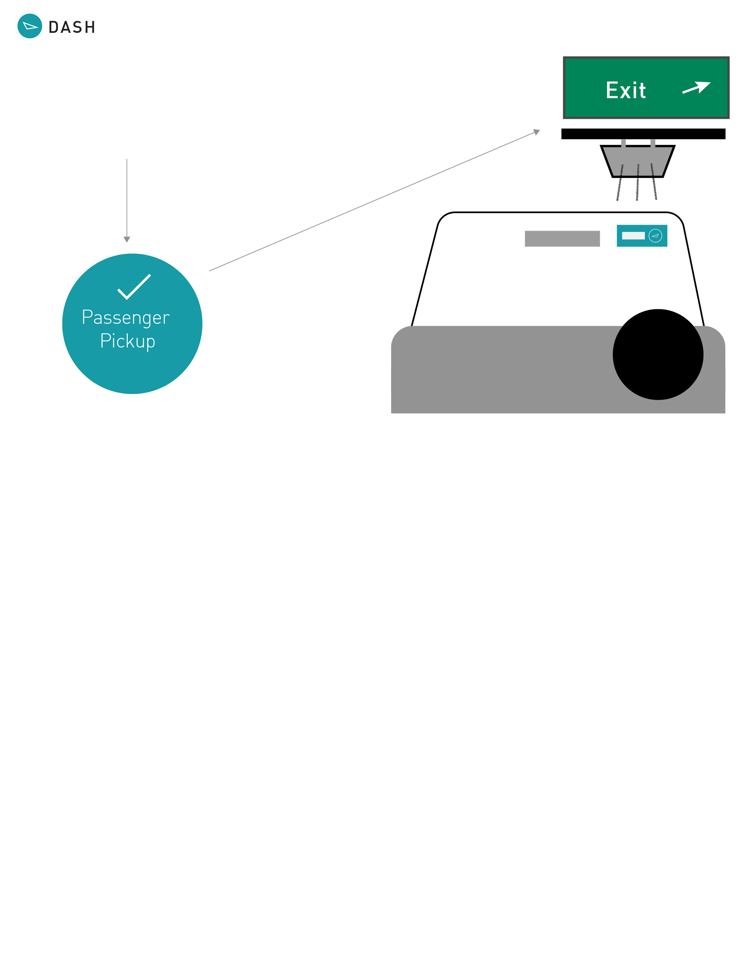

Slide 4
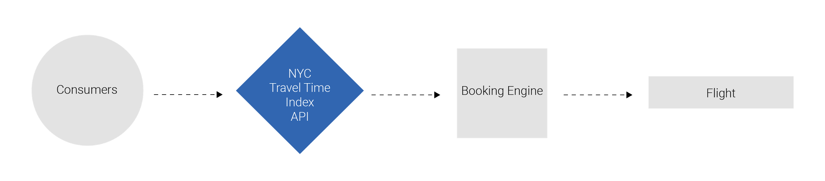
Product Narrative
Product Narrative

Slide 5
Product Narrative
Redistribute peak-time road traffic to NYC airports to off-peak times by allowing the public to easily search for flights according to the time it takes to get to or from the airport, not just price and departure time.
Product Narrative

Slide 6
WHY?

Slide 7
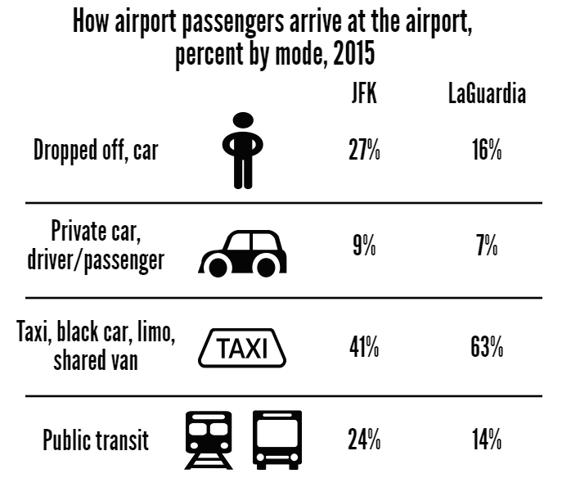
Most Passengers Use Car or TAXI to Airport
POLICY REPORT: Improving Transit Access to NYC Airports (http://pubadvocate.nyc.gov/sites/advocate.nyc.gov/files/airport_transportation_report_-_final.pdf)

Slide 8
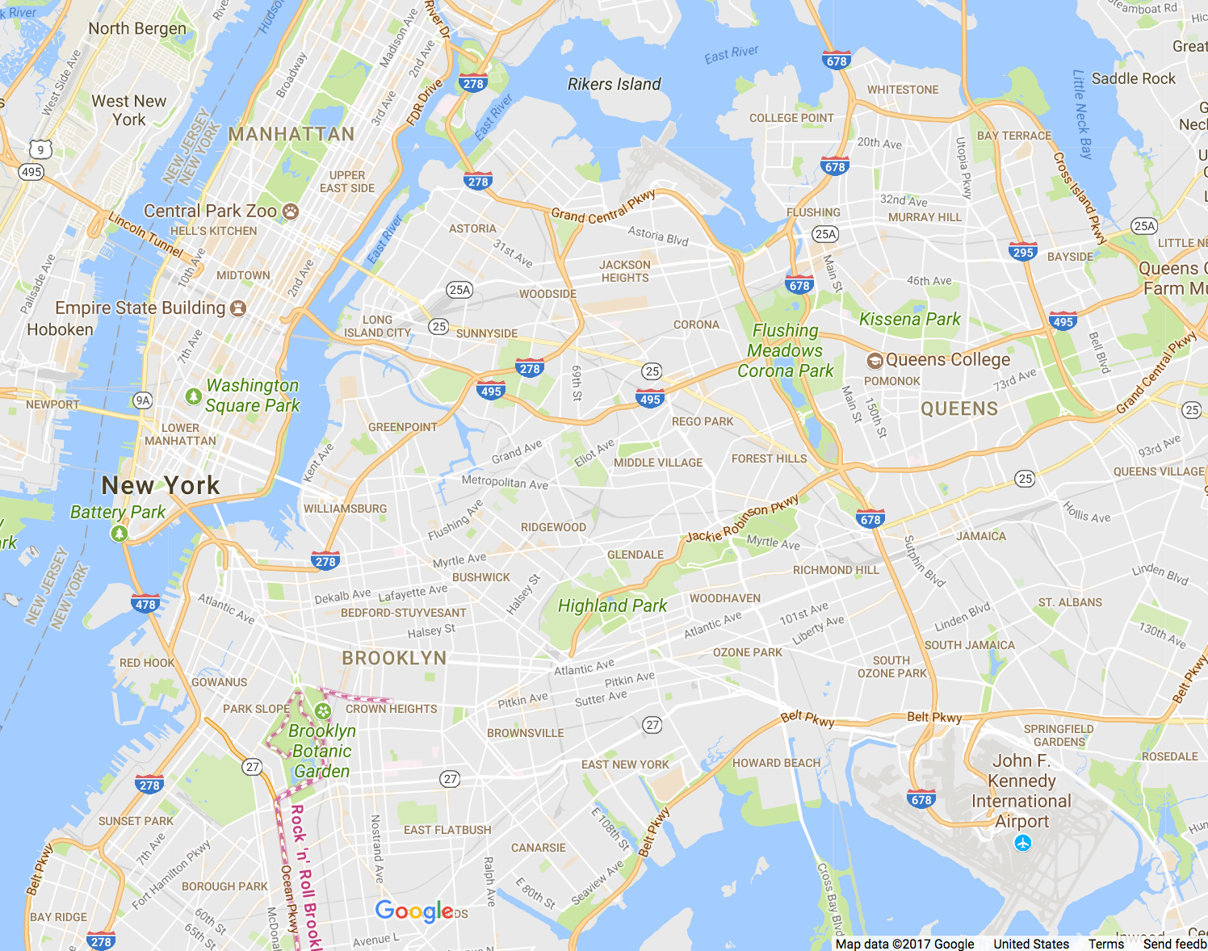
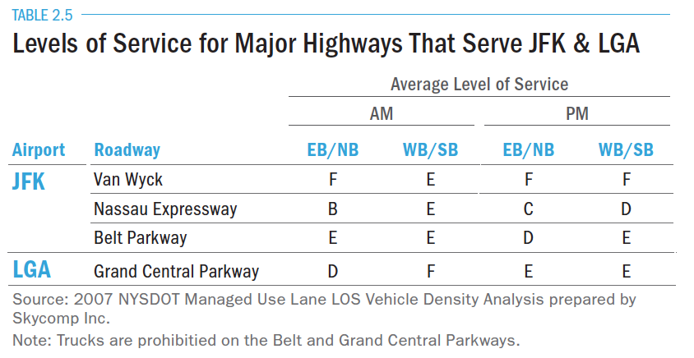
Congestion Can Cause Delays
“Expressways to the Airports are Congested, Leading to Unpredictable Travel Times”
Upgrading to World Class: The Future of New York Region’s Airports. Regional Plan Association (http://www.rpa.org/pdf/RPA-Upgrading-to-World-Class.pdf)

Slide 9
Business People Need to Save Their Time
“When you’re a business traveler, every minute spent traveling counts—lost time can mean lost productivity. But there’s no reason your work or deadlines have to suffer on account of being on the go.”
Tips for Business Travelers to Help Maximize Productivity
(https://www.americanexpress.com/us/small-business/openforum/articles/11-tips-for-business-travelers-to-help-maximize-productivity/)

Slide 10
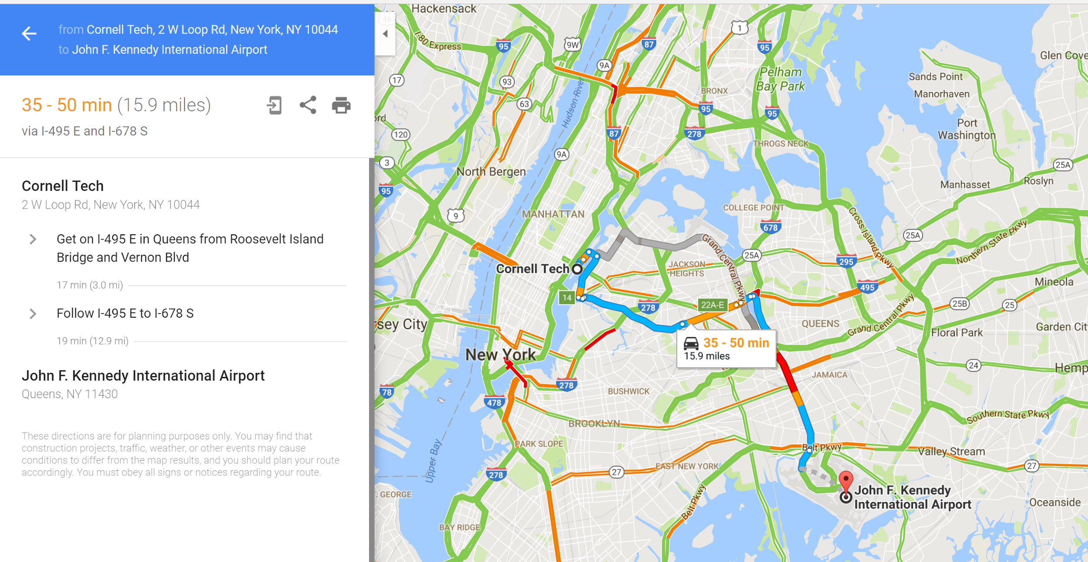
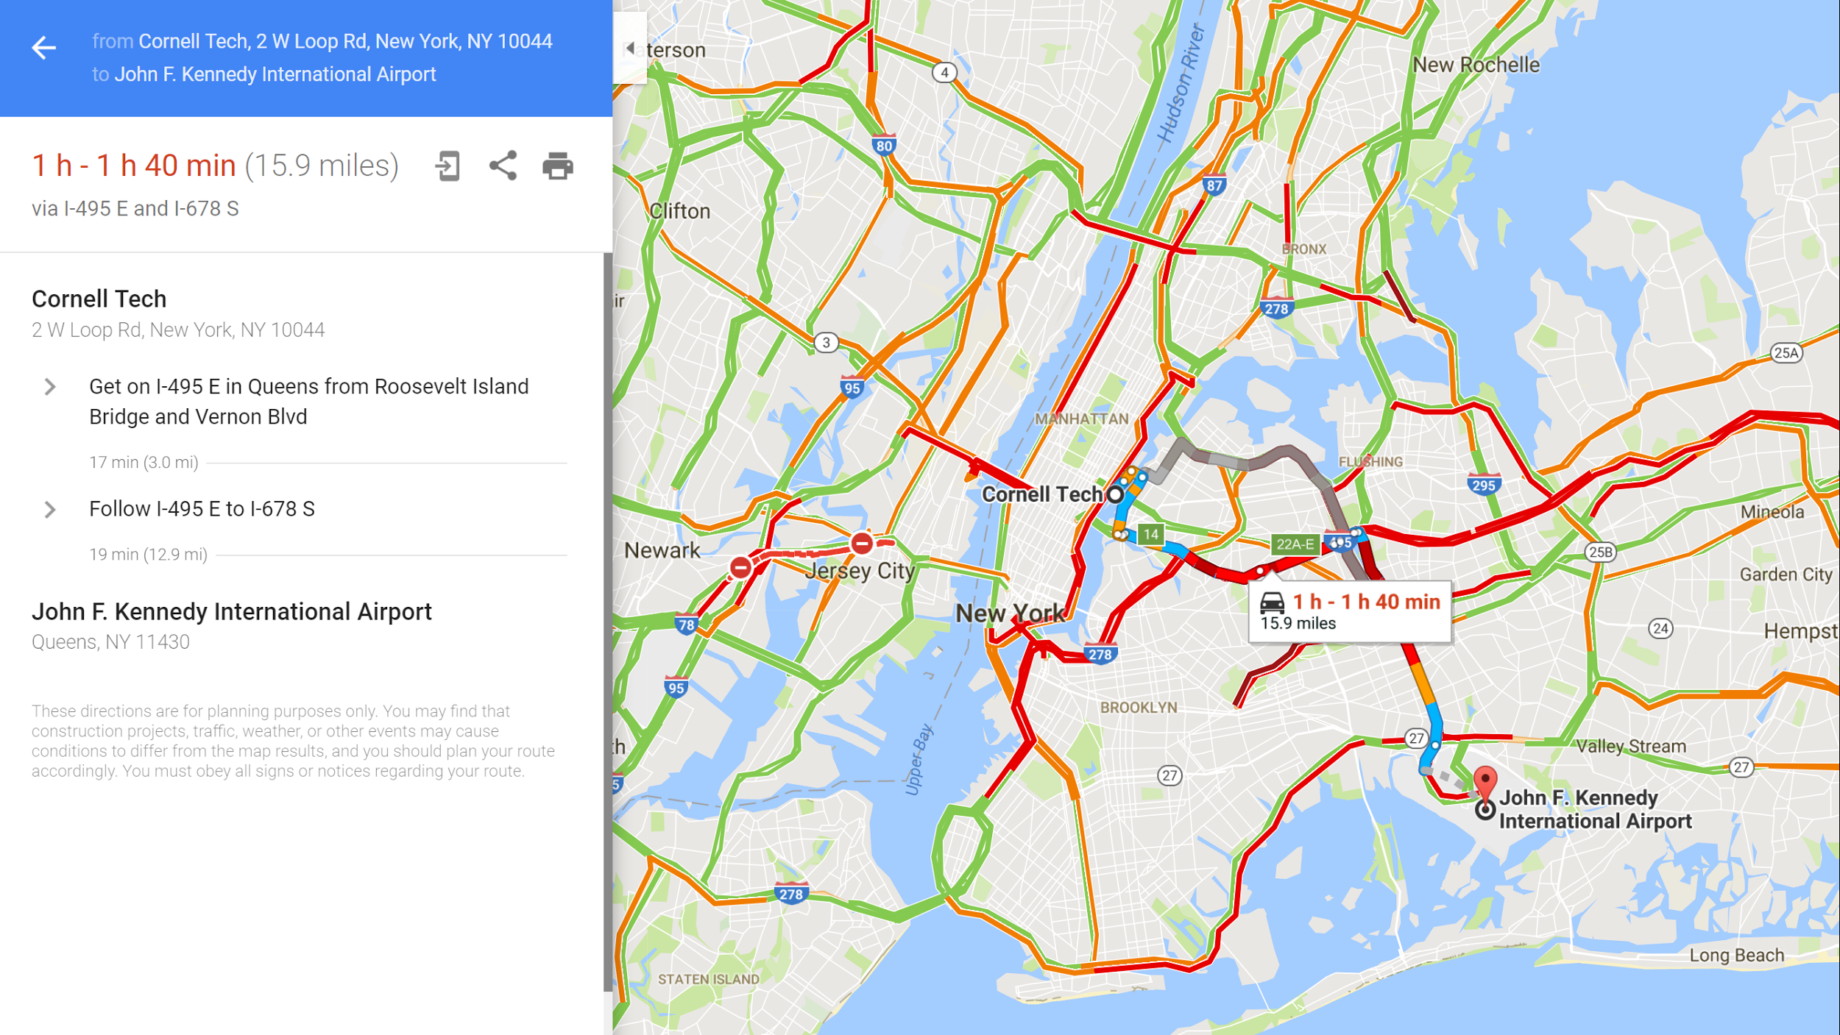
Because People Don’t Know!

Slide 11
The Sigma Index (i.e. How Painful is Your Airport Commute?)
The Sigma Index is a traffic index that measures the pain passengers experiences during their journey to the airport. It is approximated from ground travel time, queuing time and flight delay time

Slide 12
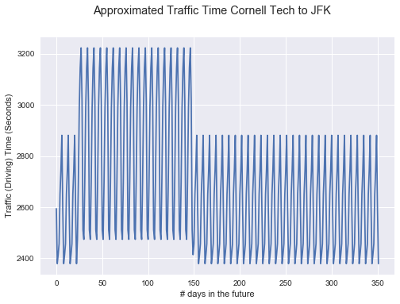
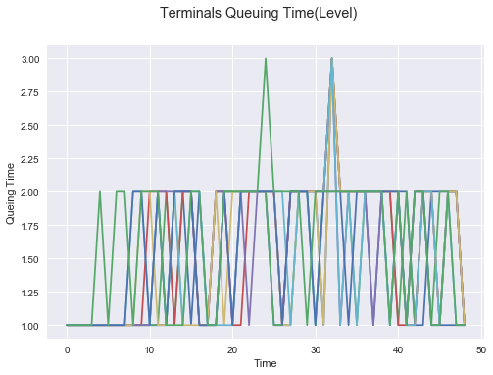
Ground Traffic Time and Queuing Time
Projected Traffic Time from Google Direction API
Simplistic Model
Margin for improvement
Historical Queuing Time for each terminal
One month of data
Integrity Check

Slide 13
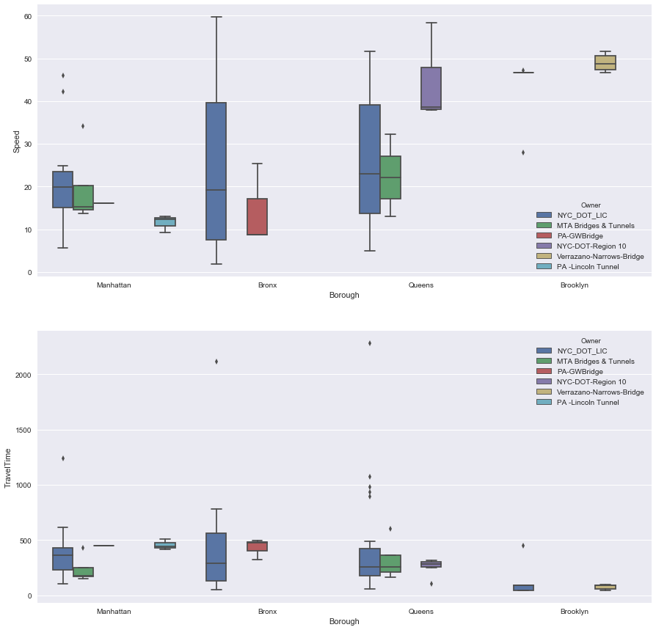
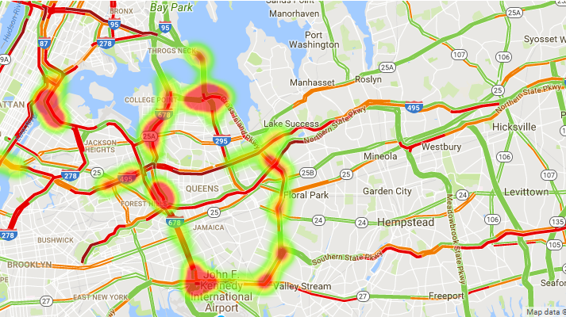
Approximate Traffic Time
Approximate Traffic based on raw traffic data sources (Camera Data etc)

Slide 14
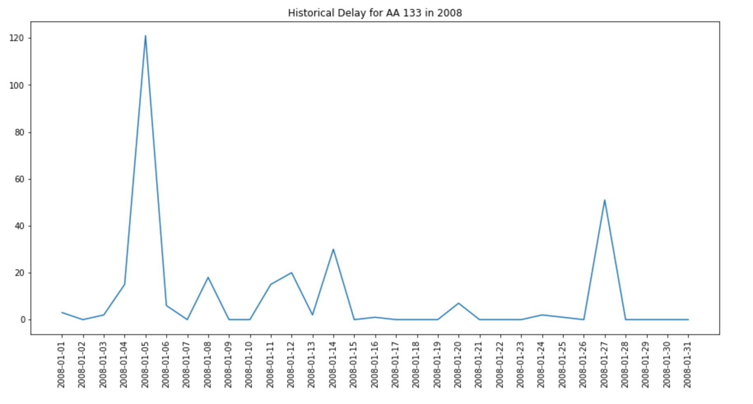
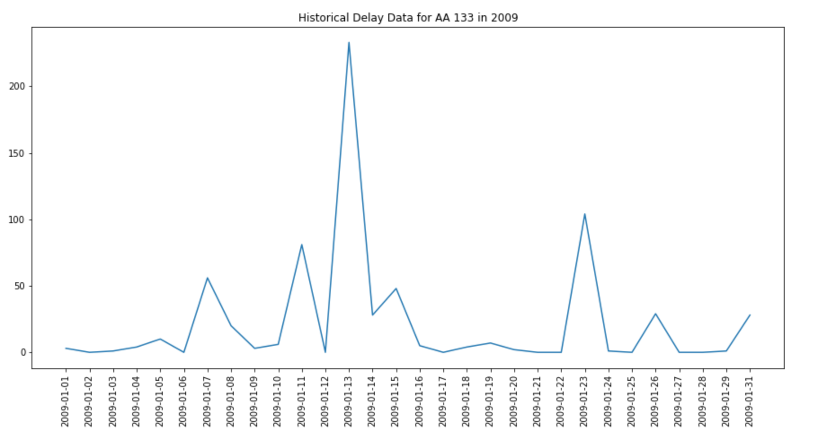
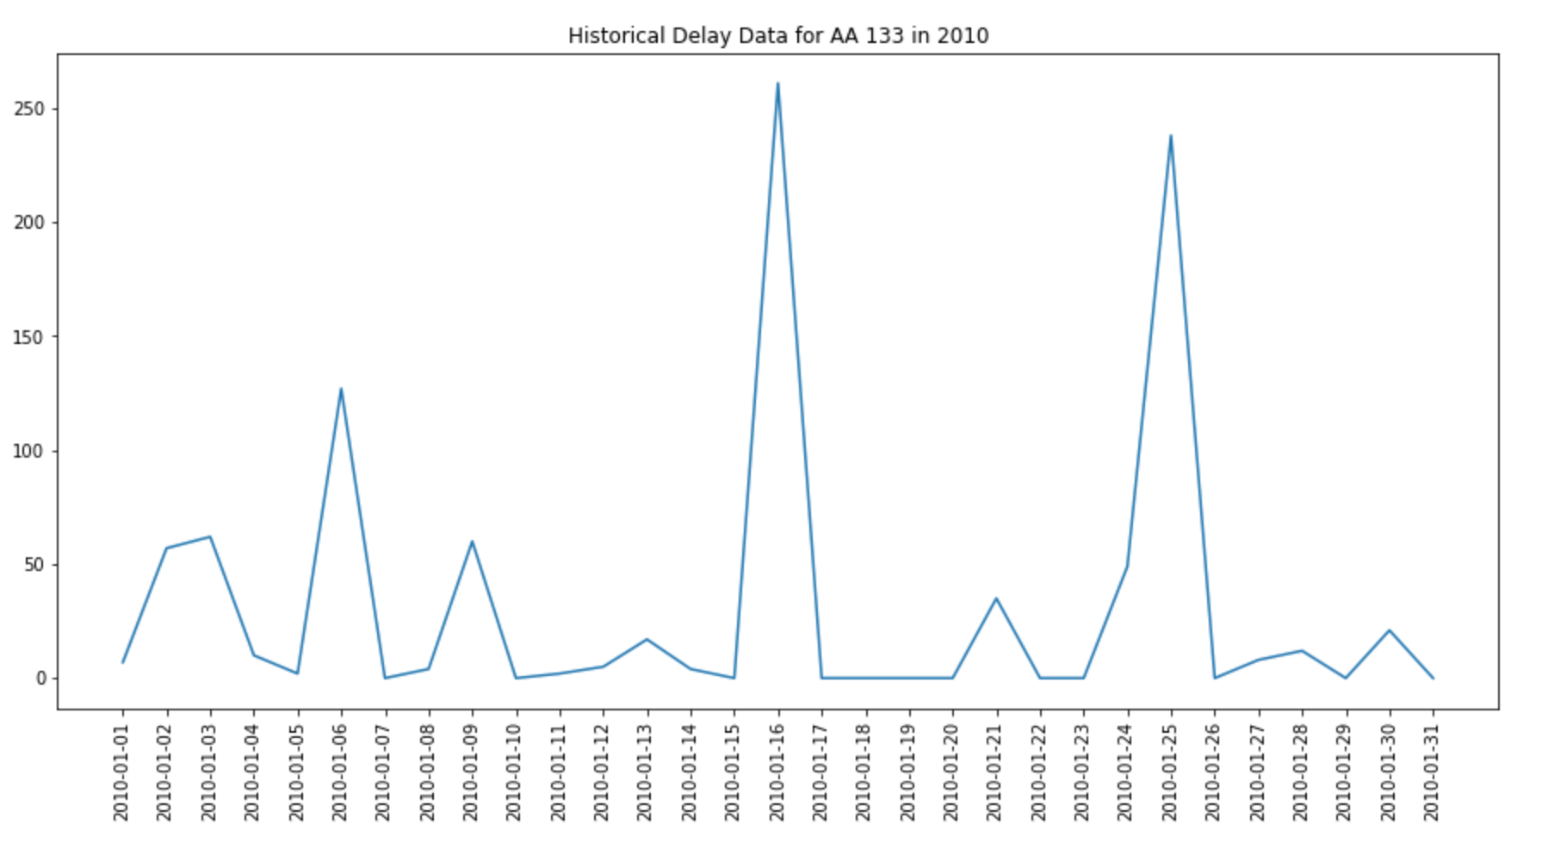
Flight Delay
Historical flight delay data
Delay for both arrival flight and departure flight in JFK
Future flight delay prediction
Explore more entities
Flight delay causes(i.e. weather, air traffic control and security )

Slide 15
Demo
Let's do this →

Slide 16







Tech Stack

Slide 17
Next Steps
Construct Data Pipeline from reliable data sources
Finalize the index formulation
Finish Connecting the back end and front end

